Slide 1
Second Look = Second Chance: Reconsidering Lengthy & Other Extreme Sentences
Featured Panelists:
Nicole D. Porter, James Zeigler, Greg Newburn & JaneAnne Murray

Slide 2
Part 1: Advocating for a Second Look
Nicole Porter
Director of Advocacy, The Sentencing Project

Slide 3
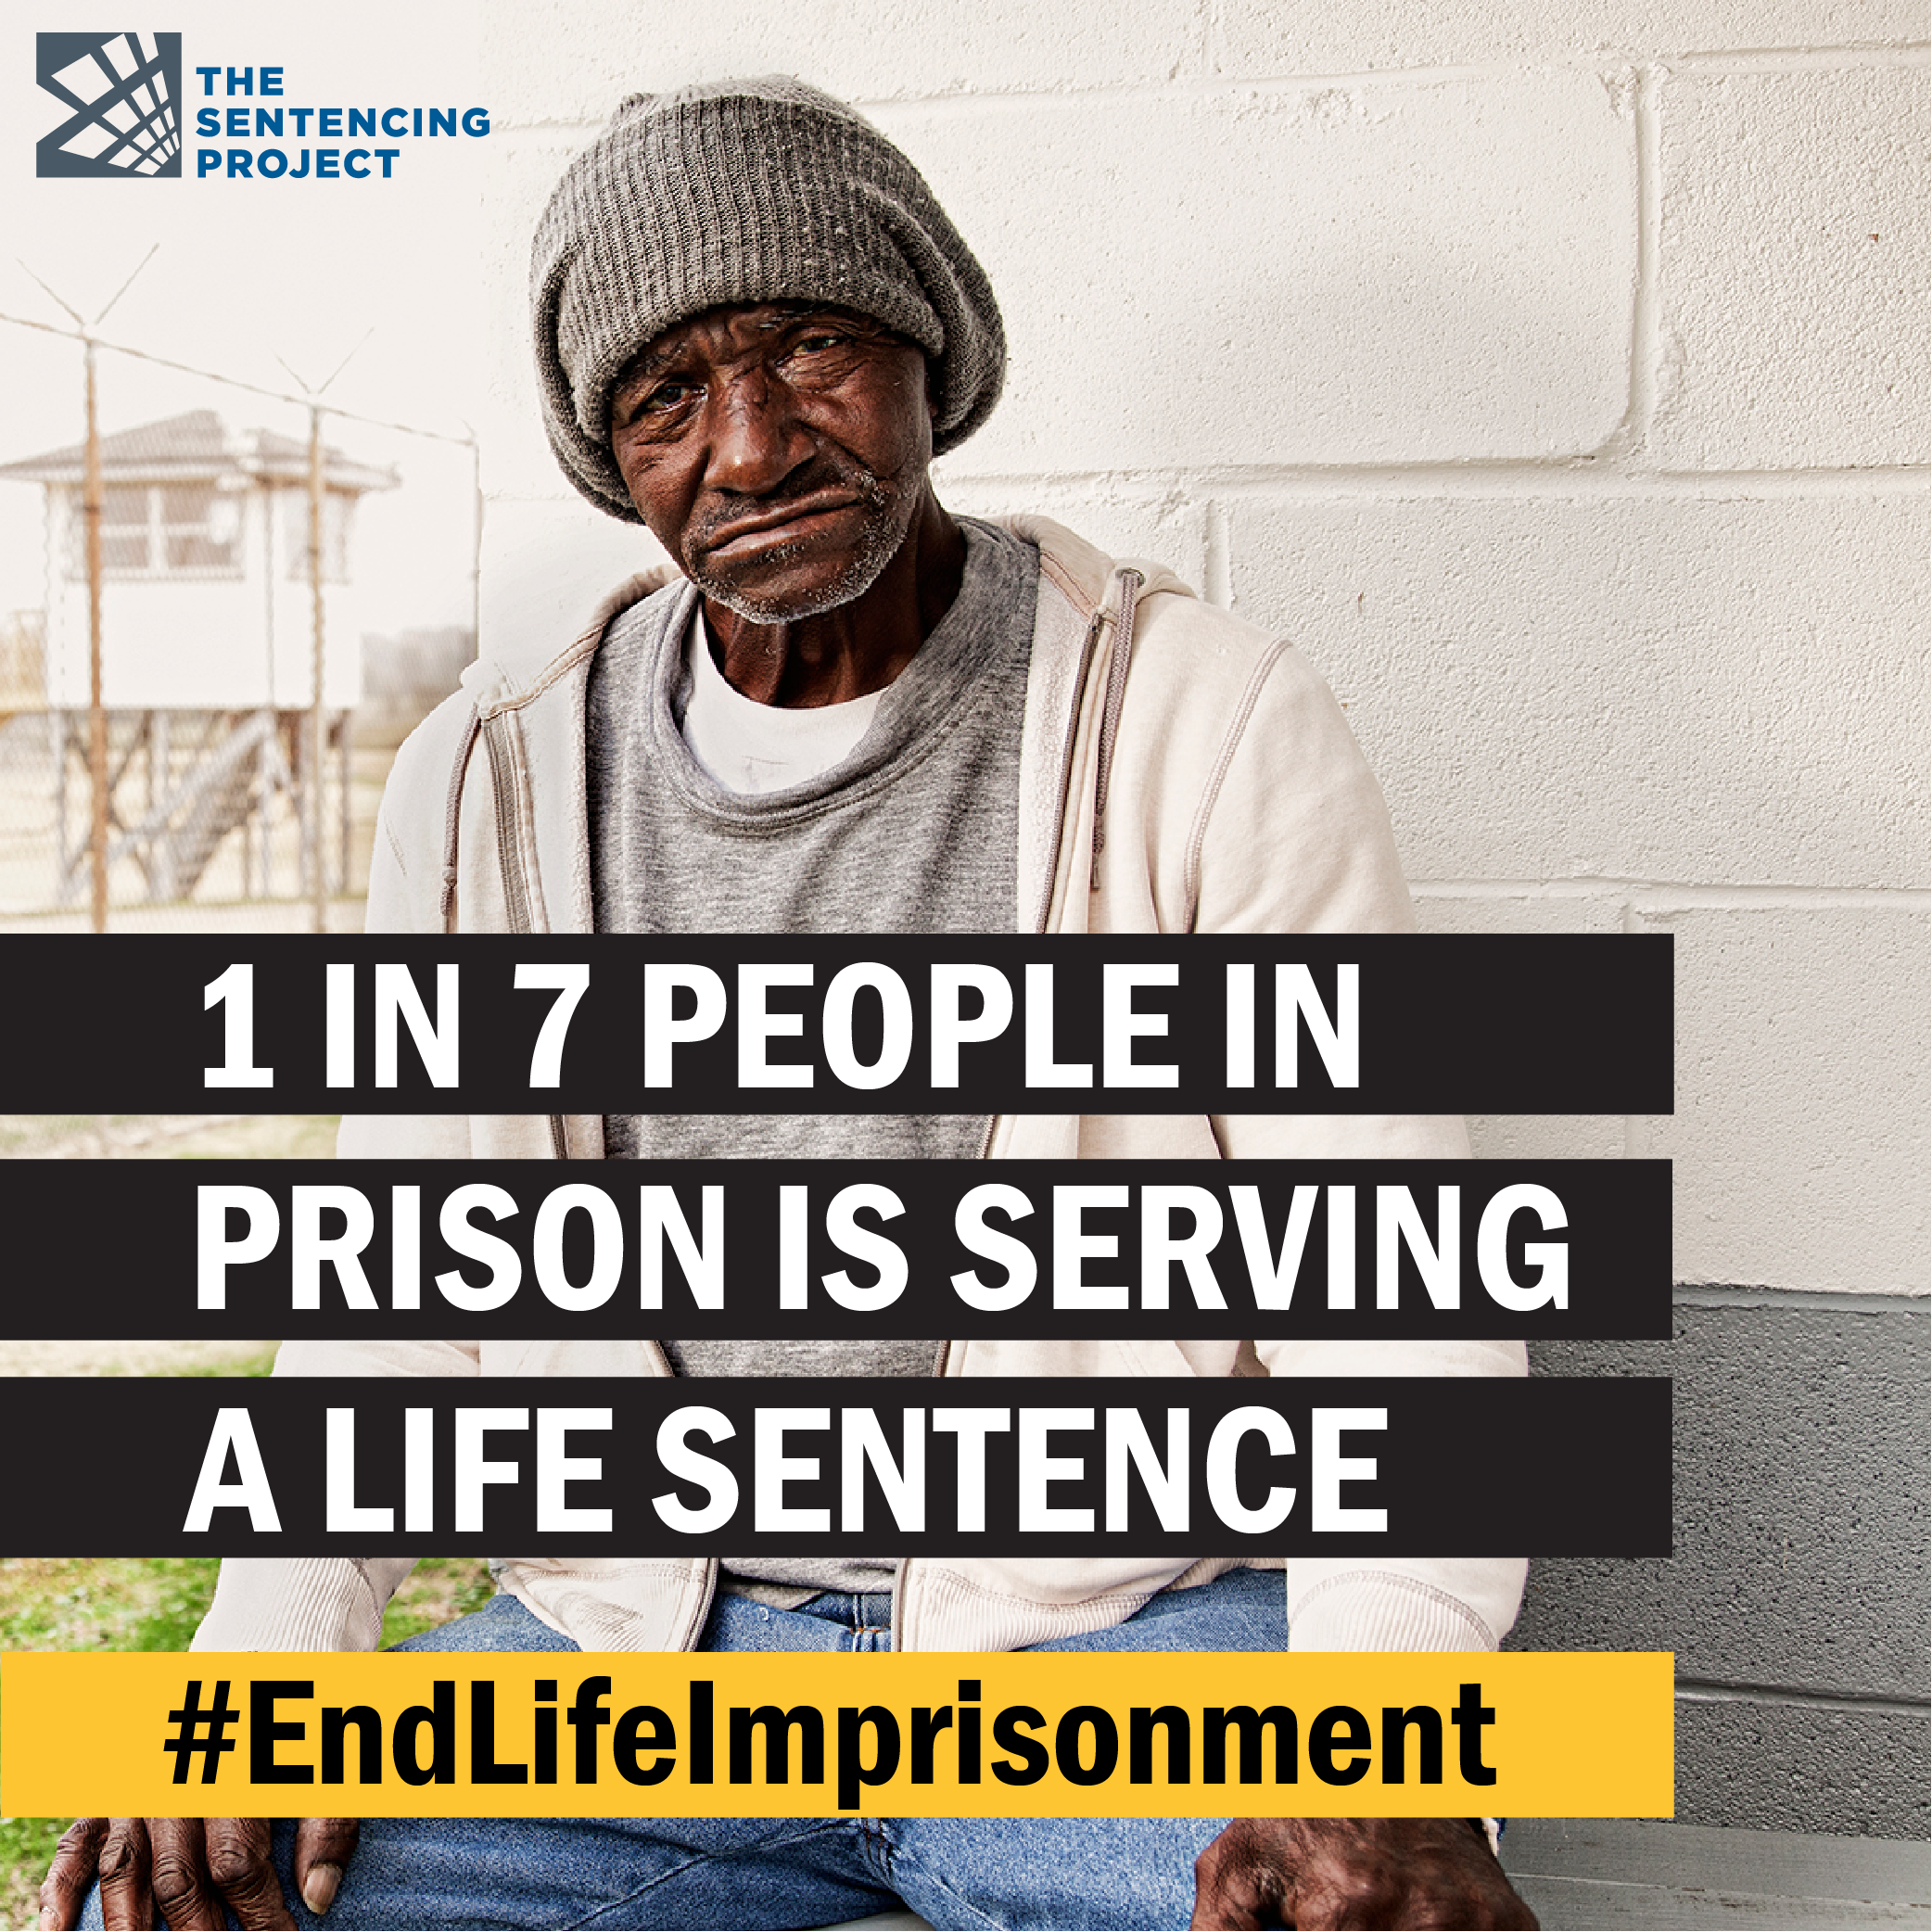
No End in Sight: Growth in Life Imprisonment
One in 7 people in U.S. prisons is serving a life sentence, either life without parole (LWOP), life with parole (LWP) or virtual life (50 years or more), totaling 203,865 people
The number of people serving life without parole — the most extreme type of life sentence — is higher than ever before, a 66% increase since our first census in 2003
More than two-thirds of those serving life sentences are people of color;
One in 5 Black men in prison is serving a life sentence;
Latinx individuals comprise 16% of those serving life sentence

Slide 4
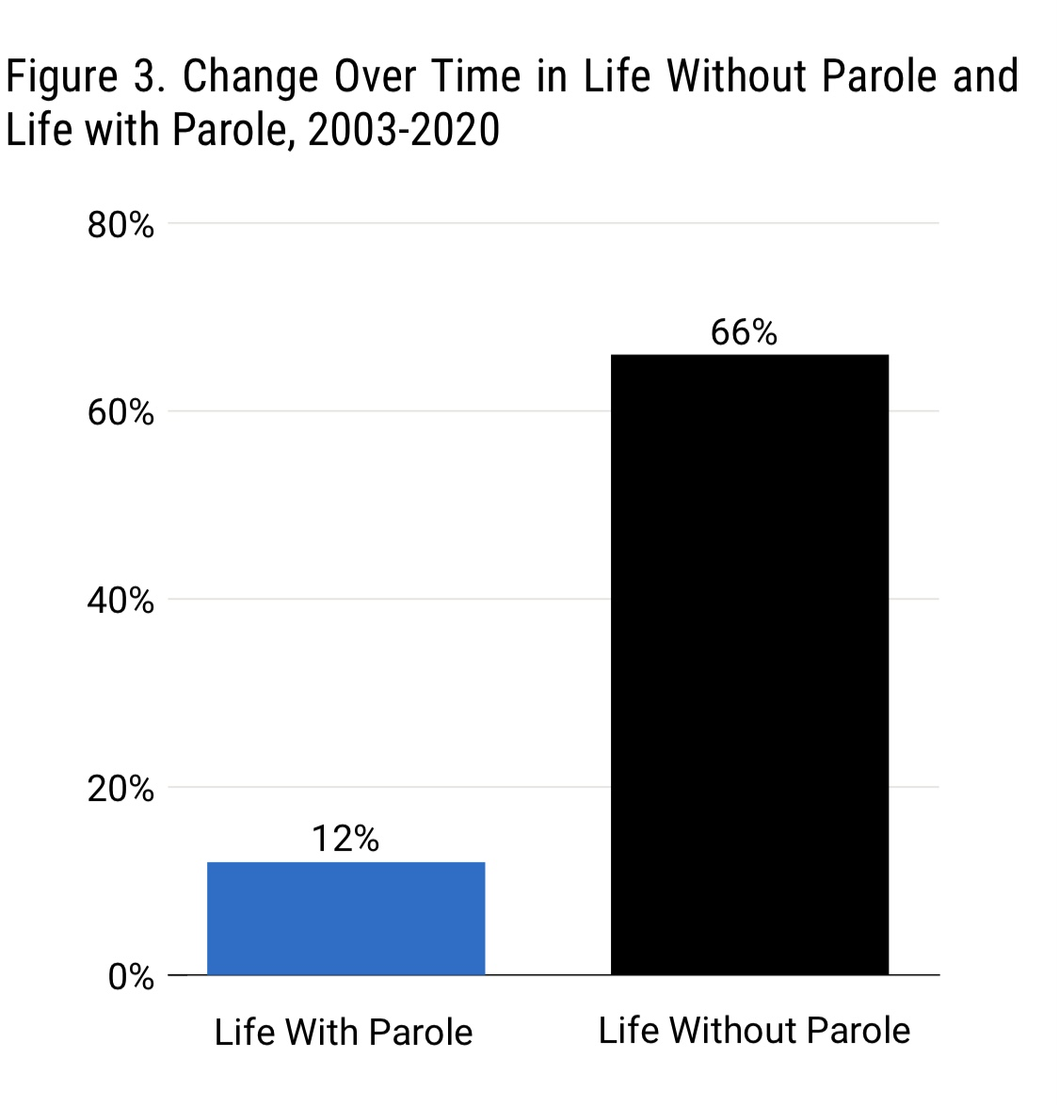
Policies that Advance a Second Look
Underlying causes lengthening prison terms demand expansions of post-conviction remedies
Statutory expansions: DC, California, and Connecticut
Sentence Review Units: Baltimore, Los Angeles
Post sentence review efforts: Ohio and Wisconsin

Slide 5
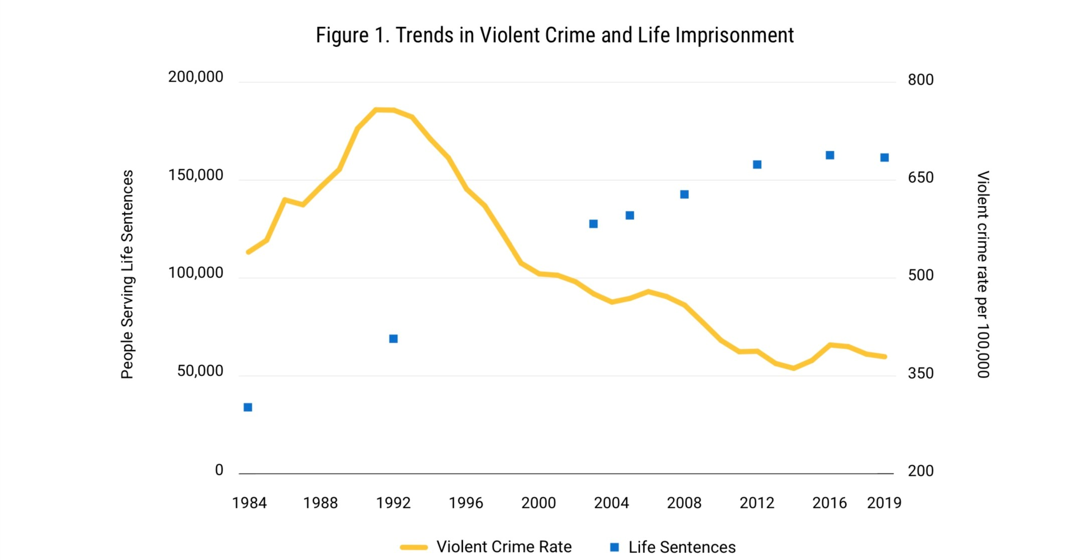
Public Safety and Life Imprisonment

Slide 6
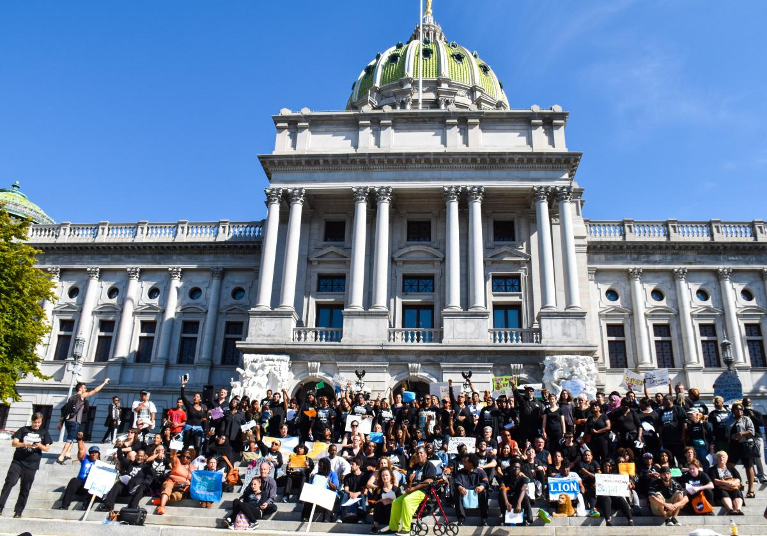
Strategizing to Advance Second Look Reforms
Litigation and case advocacy
Campaign to End Life Imprisonment: Building momentum jurisdiction by jurisdiction – endlifeimprisonment.org
Long-term strategies to recalibrate extreme sentences and create space for mid term adjustments in the short term

Slide 7
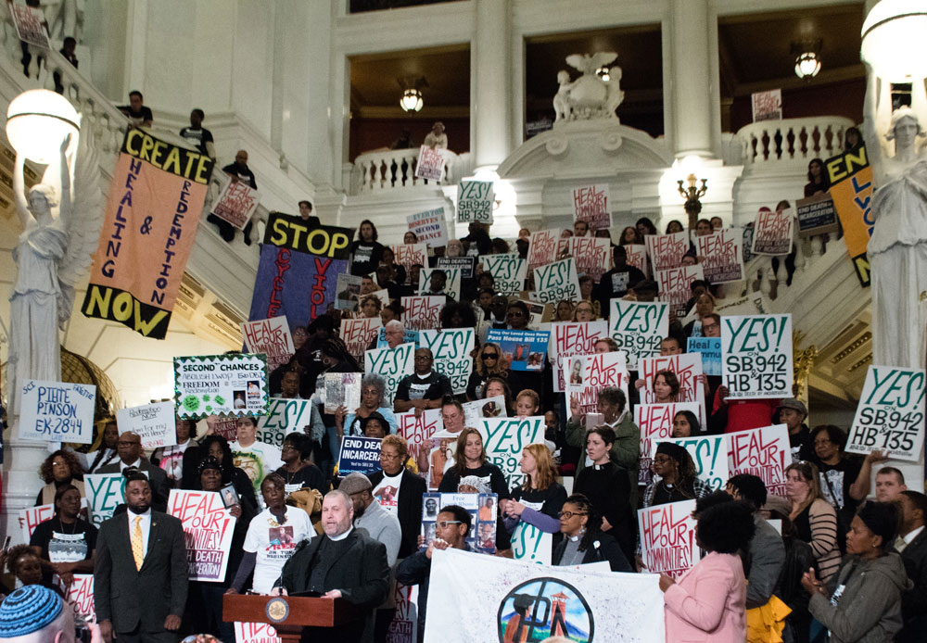
Expanding Second Looks at Reforms
Organizing a discussion
Developing a local and state narrative
Showing need and possibility for reforms

Slide 8
Part 2: Incarceration Reduction Amendment Act (“IRAA”)
James Zeigler
Executive Director,
The Second Look Project

Slide 9
History of DC’s Second Look Sentence Review Law, The Incarceration Reduction Amendment Act (“IRAA”)
Passed in 2016 as part of broader package of youth justice reforms, original version of the bill allowed relief after 20 years for those sentenced for offenses committed before 18, who were not yet parole eligible
Inspired by line of Supreme Court cases dealing with sentencing of juvenile offenders
Later amended to allow for relief after 15 years, independent of parole eligibility

Slide 10
D.C. Code § 24-403.03
Court must make two threshold findings in order to grant relief:
that the defendant is not a danger to the safety of any person or the community and
that the interests of justice warrant a sentence modification.
Statute lists factors for the Court to consider in making those findings
Factors encompass client’s entire life, from childhood social history, circumstances surrounding the offense, client’s history while incarcerated
Does not require prosecutorial approval, and prosecutors almost always oppose these cases

Slide 11
IRAA Practice Overview
Right to counsel in these proceedings
Development of mitigation case/telling the client’s life story
Records review
Mitigation specialist/other experts
Reentry plan
Drafting a petition laying out comprehensive mitigation narrative and case for release
Evidentiary Hearing

Slide 12
Success under IRAA so far
Approximately 60 people released and approximately 10 denials
Denials have been largely based on poor disciplinary histories while incarcerated, not on the underlying offense or other more subjective factors commonly seen in parole hearings (acceptance of responsibility, remorse, etc.)
Successes have almost all been over government opposition

Slide 13
The Second Look Amendment Act (IRAA 3.0)
Will expand eligibility under IRAA to those who committed their offenses before age 25
Passed by the D.C. Council in December, signed by the Mayor on January 13, expected to become law in May
Will create the broadest and most impact sentence review mechanism in the country, making an estimated 600 people sentenced for serious offenses immediately eligible for resentencing and release

Slide 14
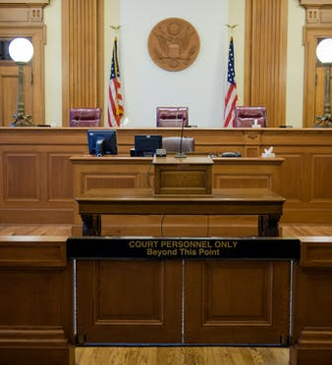
Part 3: Theoretical and Practical Objections to Second Look Sentencing
Greg Newburg
Director of State Policy – Florida at FAMM

Slide 15
Theoretical and Practical Objections
Theoretical Objections
Finality
Separation of powers
Practical Objections
Overloaded courts
Are judges the right people to modify sentences?
Effect on victims

Slide 16
Theoretical Objection 1: “Finality”
What is finality?
Why do some say second look undermines finality?
Finality of convictions v. finality in sentencing

Slide 17
Theoretical Objection 2: Separation of Powers
Second Look sentencing interferes with an exclusive executive commutation power
Legislative prerogative to define crimes and sentences v. executive power to commute sentences/grant pardons
Federal
United States v. Benz, 282 U.S. 304 (1931)
“Drugs Minus Two”
First Step Act
States
Maryland
Louisiana - State ex rel. Esteen v. La., 239 So. 3d 233 (2018)
North Carolina - In Re Briggs, 47 S.E. 403 (N.C. 1904); State v. Blalock, 61 N.C. 242
Colorado – People v. Smith, 536 P.2d 820 (Col. 1975)
“Shared decision-making legislation”

Slide 18
Practical Objection 1: Administrative Capacity
Will courts be overwhelmed by resentencing motions, many of them frivolous?
States can outline specific eligibility criteria
Courts already receive pro se filings
States that have undertaken sentence modification haven’t seen this outcome
Courts could deny without a hearing
Temporary increased court workload vs. chronic prison overload

Slide 19
Practical Objection 2: Who Should Modify?
Are judges really the best people to modify sentences?
Judges v. parole boards
Disparities?

Slide 20
Practical Objection 3: What About Victims?
By my lights, easily the most difficult objection
Resentencing means re-litigating relevant parts of the offense
Victims really do have legitimate expectations and interests in finality
Those interests should not control the outcome, i.e., act as a “pre-veto,” but should be weighed against (similarly legitimate) interests in justice and individual liberty
Relevant notice and input
“Seen v. Unseen” victims
Restorative justice?
Sometimes there is no “victim”

Slide 21
Sources
Meghan J. Ryan, Finality and Rehabilitation, 4 Wake Forest J.L. & Pol’y 121, 123 (2014)
Douglas A. Berman, “Re-Balancing Fitness, Fairness, and Finality for Sentences,” Public Law and Legal Theory Working Paper Series No. 243 (May 2, 2014)
Cecelia Klingele, “Changing the Sentence without Hiding the Truth: Judicial Sentence Modification as a Promising Method of Early Release”, 52 Wm. & Mary L. Rev. 465 (2010)

Slide 22
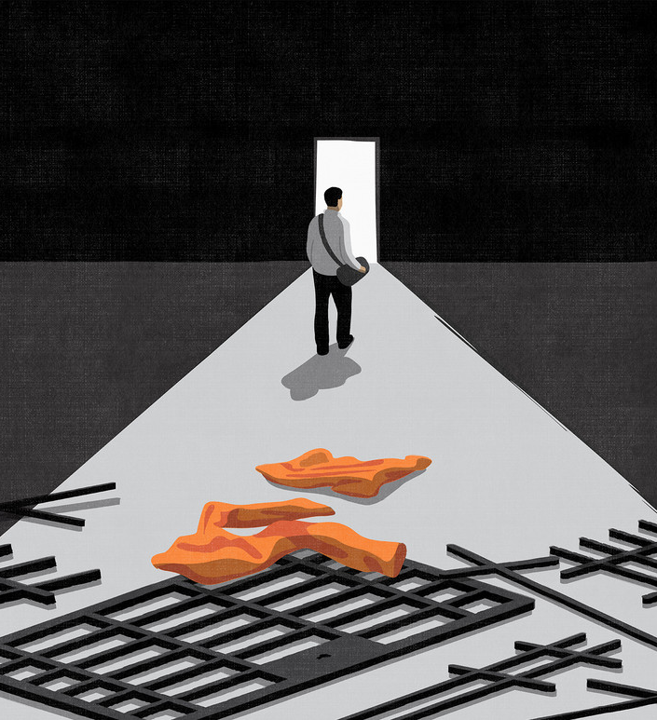
Part 4: NACDL’s Model Second Look Legislation
JaneAnne Murray
Based on:
Draft Legislation by NACDL Second Look Taskforce and Report by JaneAnne Murray, Sean Hecker, Michael Skocpol and Marissa Elkins

Slide 23
Model Penal Code (Sentencing), Dec. 2018 Principles for Legislation
Judicial “second look” after 15 years served
Review at no more than 10-year intervals thereafter
Harnesses DOC to commence process
Judge has discretion to appoint counsel
Permits summary dismissal of petition
Ensures and cabins victim participation
Sets forth review process
Commission to establish guidelines
Animated by principle of humility

Slide 24
NACDL’s Model Second Look Legislation: Key Components
Judicial “second look” after 10 years served
Review at no more than 5-year intervals thereafter
Harnesses DOC to commence process
Petitioner has right to appointed counsel
Requires a face-to-face hearing
Sets forth factors that must be considered
Ensures and cabins victim participation
Petitioner has right to appellate review
Animated by principles of humility and humanity

Slide 25
Why Ten Years?
NACDL follows FAMM and Sen. Cory Booker in seeking second look after 10 years
Still confines “second look” to those serving very long sentences (10 years served would often mean a sentence of 15 years or more at state level)
Permits opportunity for retroactive application of changed charging practices and sentencing policies and new social science insights
This threshold is humane – offers hope and incentivizes rehabilitation

Slide 26
Why Representation?
NACDL (like FAMM and Sen. Cory Booker) includes provision requiring appointment of counsel
Counsel is more effective
Hard to advocate for oneself from prison
Multiple recent analogues indicate that large-scale representation is viable
“I’ve heard mitigating things about you.”

Slide 27
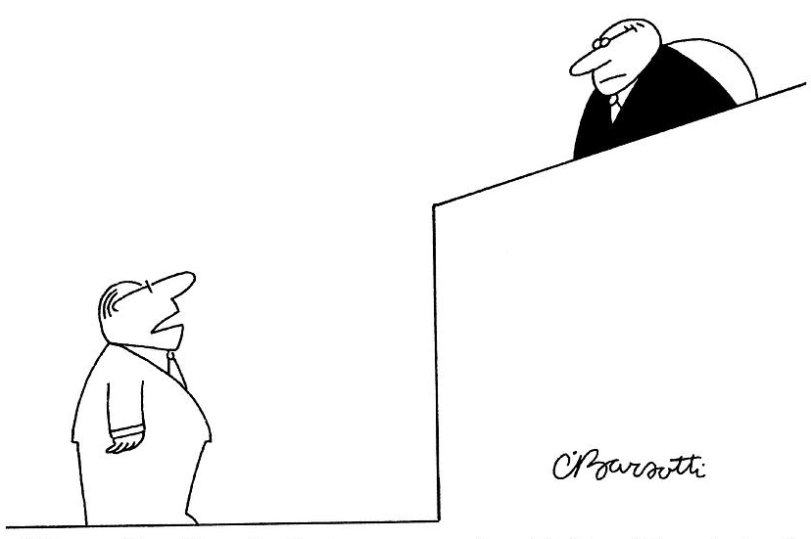
Our Proposed Process
DOC identifies eligible petitioners
Petitioner can file easily
Hearing required; does not need to be full-blown evidentiary one but must be involve “face to face” in-person or virtual meeting between judge and petitioner
Delineates who should be 2d look judge, what is appellate procedure and whether the right can be waived (answer: not)
Sets forth lengthy series of factors to be considered
“The past, Your Honor, is a foreign country, and we did things differently there.”

Slide 28
Factors to Be Considered
Age at time of offense and time of petition
Nature of the offense
Petitioner’s history and current characteristics
Petitioner’s role in the original offense
Current health and mental health status
Victim impact statement
Did petitioner suffer a trial penalty?
Did petitioner receive IAC?
Is there an innocence issue?
Key issue: would sentence be lower today

Slide 29
Role of Victims
At state level, majority is incarcerated for violent crime
“Second look” has potential to retraumatize victims
MPL and NACDL propose orderly procedure for victim participation in second look process
Presents opportunity for restorative justice

Slide 30
Getting Second Look Legislation Passed
Uphill battle against precedent, tradition, culture (see Part 3)
Floodgates (burden on courts and cost) . . . but at $30K per prisoner per year, the mechanism more than pays for itself
Studies show early release does not increase recidivism for similarly situated prisoners who serve entire sentence, see e.g.
Public opinion is changing and open to this kind of reform
This issue is bipartisan
Second look legislation is being passed (e.g., DC, Florida, New York DVSJA)

