Slide 1
Supervision for People with Disabilities
February 6, 2025
Presented by West Resendes and Brian Dimmick, ACLU Disability Rights Program; Allison Frankel, ACLU Criminal Law Reform Project

Slide 2
Background: Supervision and Disability

Slide 3
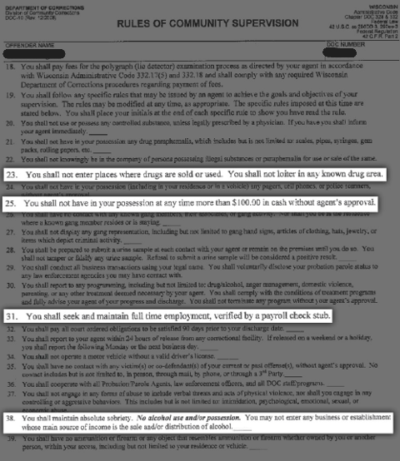
Criminal Supervision Overview
3.7 million people, or 1 in every 71
Must follow 10-20 rules per day
Rules are complex & conflicting
Lasts for years, decades, or life
Risk of incarceration for any violation
Background: Supervision and Disability

Slide 4
Overrepresentation of Disability
Higher rates of:
Mental health conditions
Substance Use Disorder
Intellectual/developmental disabilities
Chronic illnesses
Hearing and vision disabilities
Background: Supervision and Disability

Slide 5
Barriers to Supervision for People with Disabilities

Slide 6
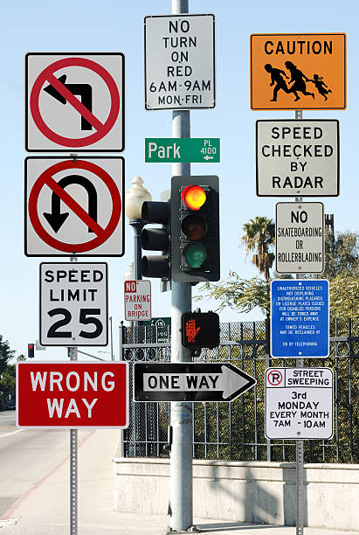
Barriers to Understanding Conditions
Effectively communicating about conditions given vision and hearing disabilities
Comprehending conditions with cognitive disabilities
Remembering and keeping track of conditions due to memory difficulties
Barriers to Supervision for People with Disabilities

Slide 7
Barriers to Effective Engagement
Effectively communicating during meetings for people who are deaf/hard of hearing
Trusting and engaging with supervision authorities given mental health conditions
Stigma against certain disability-related behaviors (e.g., fidgeting, difficulty focusing, speaking loudly)
Barriers to Supervision for People with Disabilities

Slide 8
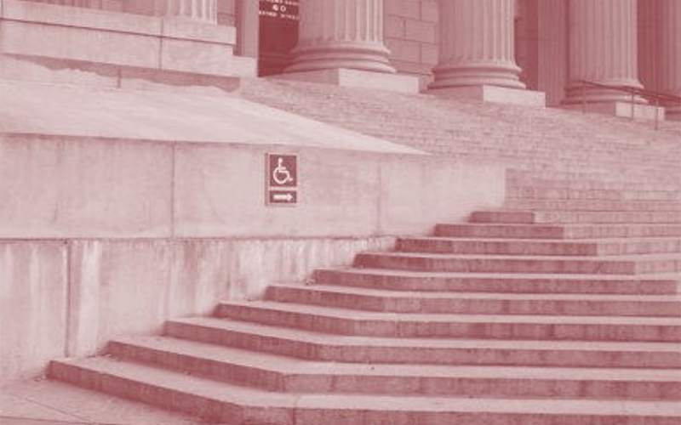
Barriers Getting to Required Appointments
Inaccessible meeting locations
Transportation barriers
Triggering due to site of prior trauma
Difficulty leaving home given anxiety, depression, or paranoia
Trouble remembering or planning for meetings given cognitive disabilities
Barriers to Supervision for People with Disabilities

Slide 9
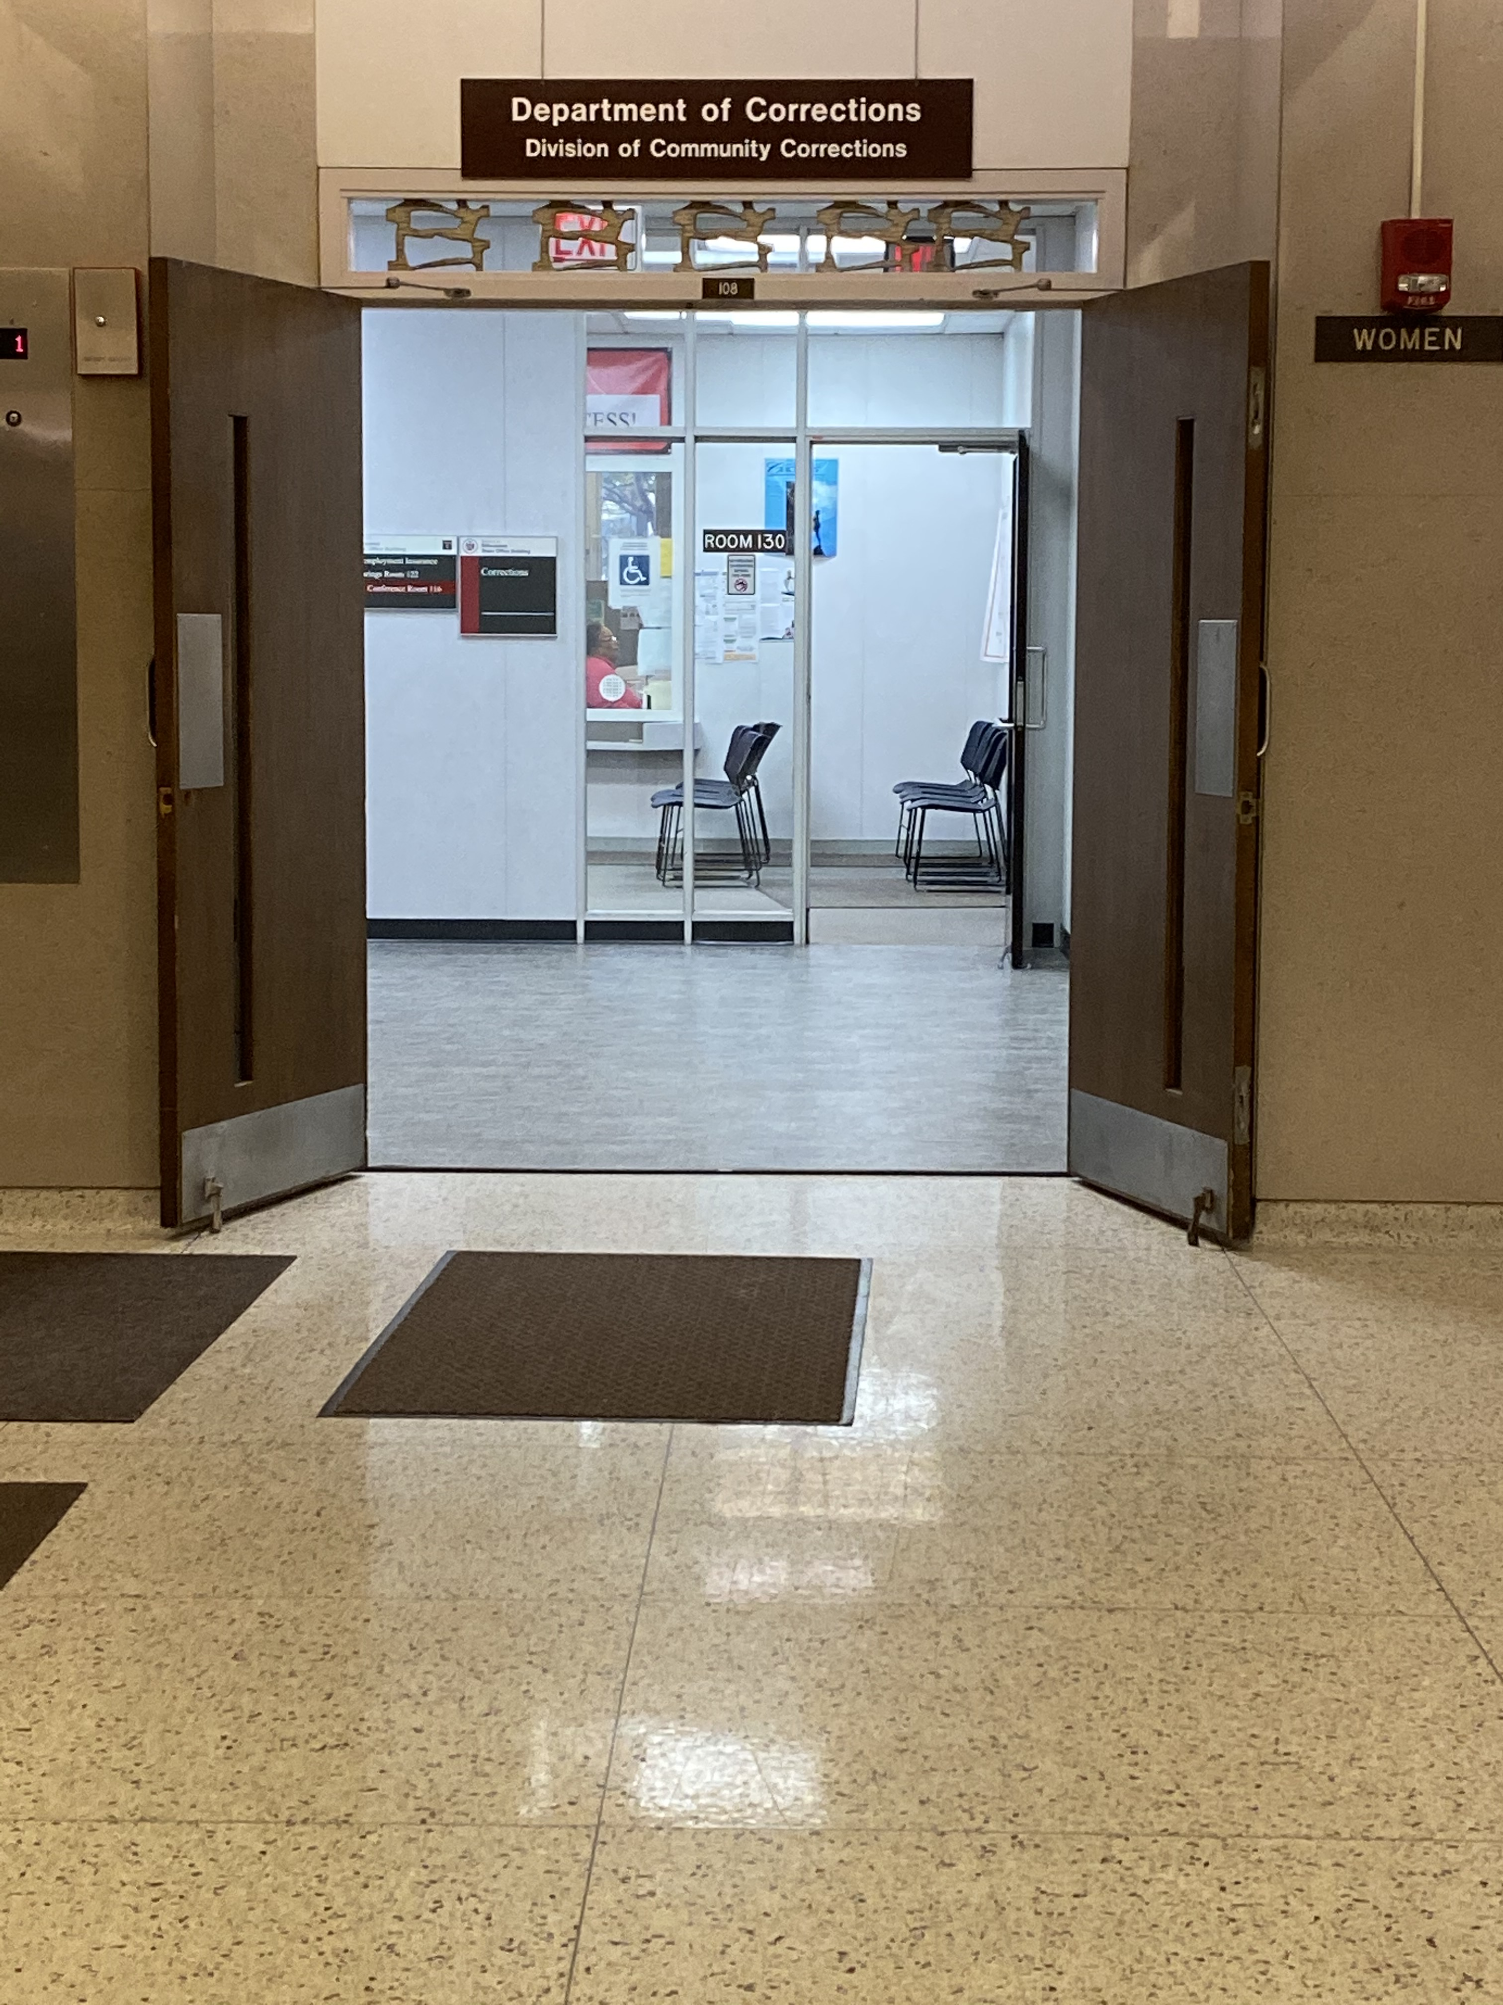
Barriers to Engaging in Mandated Treatment
Navigating logistics to enroll in treatment
Programs inappropriate to disability-related needs
Prohibitions on Medication-Assisted Treatment (MAT)
Violates ADA if the individual has Opioid Use Disorder
Barriers to Supervision for People with Disabilities

Slide 10
Additional Obstacles
Structural Barriers: Housing, job, healthcare access​
​
Unequal Treatment: Closer surveillance, more conditions, heightened chance of incarceration​
Lack of Accommodations Systems: Few supervision agencies have systems to proactively assess/provide accommodations
Barriers to Supervision for People with Disabilities

Slide 11
Real-World Examples
Barriers to Supervision for People with Disabilities

Slide 12
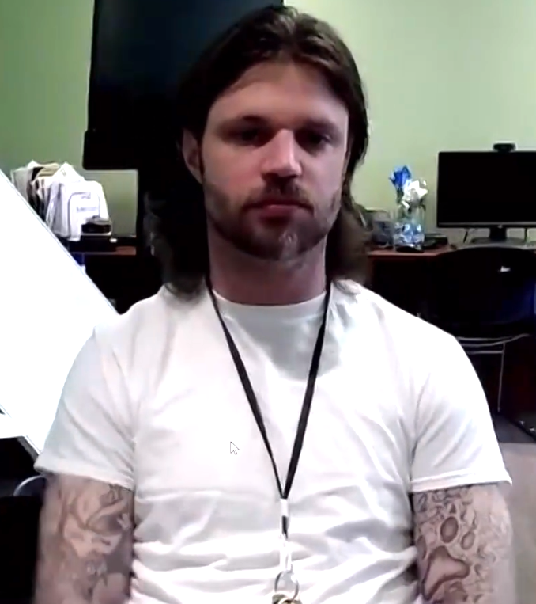
Real-World Examples Cont’d
Barriers to Supervision for People with Disabilities

Slide 13
Video Slide
Notes:
Transcript available here: https://aclunational-my.sharepoint.com/:w:/g/personal/wresendes_aclu_org/EVPz8IagfENDnPQ75FVmn8MBwHp_h-eEIrh8KvTE_eoMnw?e=sLWKc1

Slide 14
Disability Discrimination Legal Framework

Slide 15
Americans with Disabilities Act
Covers the activities of state and local government entities
Includes court systems
Also includes supervision agencies
Federal supervision—not directly covered by the ADA
Disability Discrimination Legal Framework

Slide 16
Americans with Disabilities Act
“[N]o qualified individual with a disability shall, by reason of such disability, be excluded from participation in or be denied the benefits of the services, programs, or activities of a public entity, or be subjected to discrimination by any such entity.”
42 U.S.C. §12132
Disability Discrimination Legal Framework

Slide 17
What is a Disability?
Physical or mental impairment that substantially limits one or more major life activities
Broad coverage
Not a demanding standard
Not just physical/mobility disabilities
Includes mental health conditions and hidden disabilities
Disability Discrimination Legal Framework

Slide 18
Substance Use Disorder
The ADA does not cover people engaged in the current illegal use of drugs
But it does cover:
Those in recovery not currently using
Those dependent on alcohol
Those with a record of addiction and treatment
Disability Discrimination Legal Framework

Slide 19
Discrimination Under the ADA
Available Legal Theories
Unequal Treatment
Lack of equal opportunity
Integration mandate
Failure to make reasonable modifications
Failure to provide effective communication
Disability Discrimination Legal Framework

Slide 20
Reasonable Accommodations
Reasonable Accommodations: Changes to the rules or how things are done that allow a person with a disability an equal opportunity to succeed
May involve removing or altering otherwise-required conditions
Inherently individualized
Interactive process
Disability Discrimination Legal Framework

Slide 21
Reasonable Accommodations Cont’d
Agencies must proactively assess accommodation needs
But best practice to request needed accommodations
No “magic words”
Ask about system to request accommodations & ADA coordinator
Sometimes need documentation
Disability Discrimination Legal Framework

Slide 22
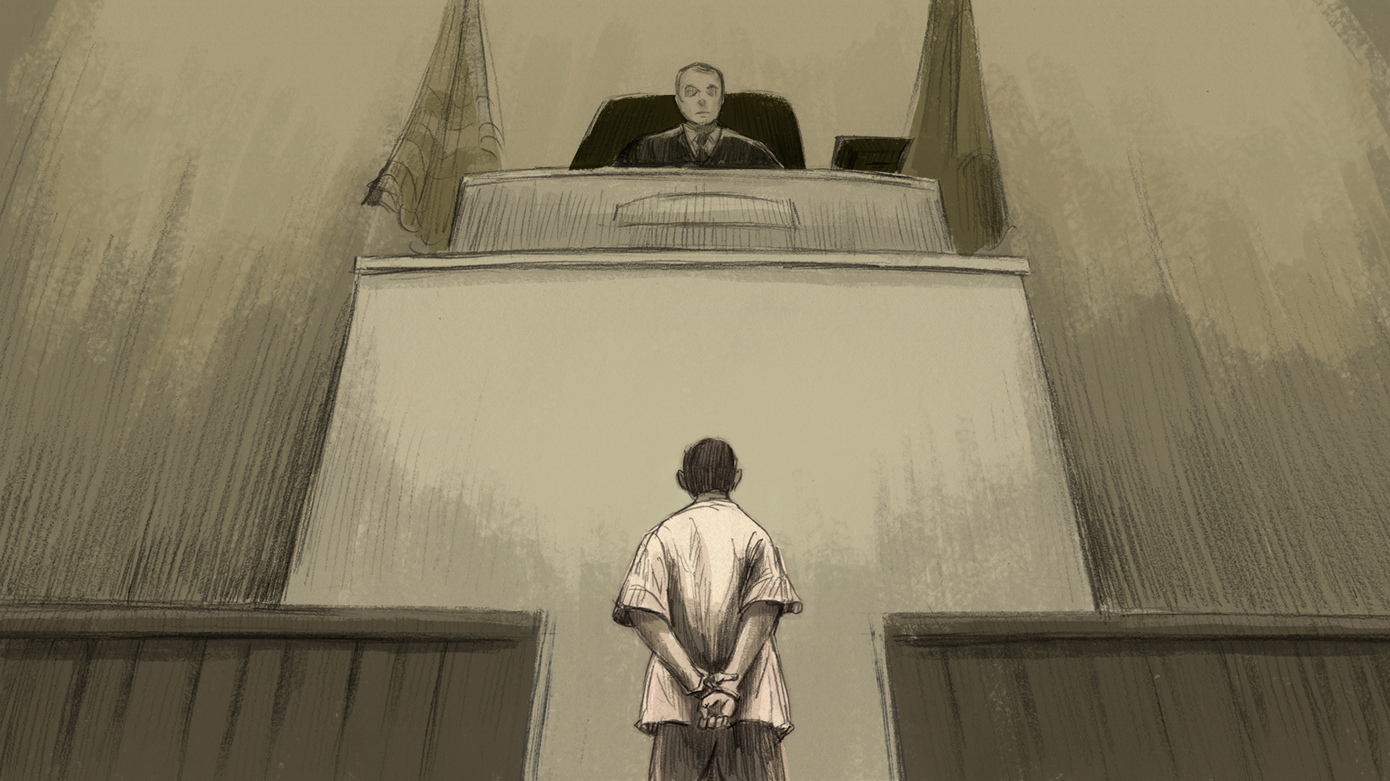
Reasonable Accommodations: Defenses
Defenses:
Fundamental Alteration
“Direct Threat”
Response:
Govt needs specific, individualized evidence of burden/threat
Disability Discrimination Legal Framework

Slide 23
Effective Communication – Auxiliary Aids & Services for Hearing Disabilities
Qualified sign language interpreters
Real-time captioning
Assistive listening devices
Captioned phones
Video Relay Services
Disability Discrimination Legal Framework

Slide 24
Effective Communication – Auxiliary Aids & Services for Vision Disabilities
Braille materials
Large Print materials
Audio recordings
Screen readers
Magnification software
Disability Discrimination Legal Framework

Slide 25
Effective Communication – Preferred Method of Communication (PMC)
Way that the disabled person prefers to receive information and communicate with others, considering their individual needs and circumstances
Primary Consideration
Obligation to provide an alternative aid or service if not using PMC
Increased likelihood of understanding with PMC
Disability Discrimination Legal Framework

Slide 26
Effective Communication – Plain Language
Barrier to Understanding
Clear, concise, well-organized
Typically relies on:
Reader-Centered Organization | Active, not passive, voice | Short sentences and paragraphs
“You” and other pronouns | Common, everyday words | Simple design features (e.g., tables!)
Disability Discrimination Legal Framework

Slide 27
Effective Communication – A Real-World Application
Deaf Interpreters
Disability Discrimination Legal Framework

Slide 28
Supervision Litigation: Cobb v. Georgia Department of Community Supervision

Slide 29
Lawsuit
Filed in Northern District of Georgia in 2019
Alleged that Georgia Department of Community Supervision was:
Denying equal access to the benefits of supervision
Failing to provide effective communication
Cobb v. GDCS Case Study

Slide 30
Lawsuit
District court certified a class and denied summary judgment
2022 WL 22865202 (N.D. Ga. Oct. 13, 2022)
Cobb v. GDCS Case Study

Slide 31
The Settlement
Communication Assessment
Communication Plan
Appropriate use of auxiliary aids
Cobb v. GDCS Case Study

Slide 32
Supervision Litigation: Mathis v. United States Parole Commission

Slide 33
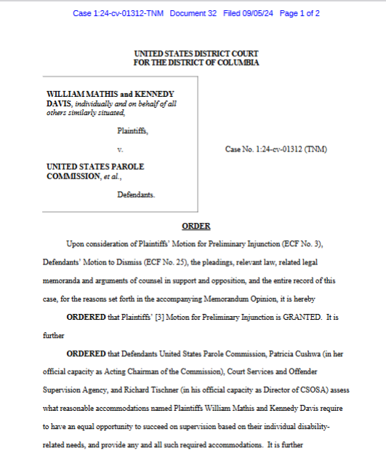
Mathis v. USPC
Systemic failure to accommodate people on parole/supervised release in Washington, D.C.
Covers all types of disabilities
Court rejected Motion to Dismiss & granted Preliminary Injunction requiring accommodations for named Plaintiffs
Awaiting class-cert decision
Mathis v. USPC Case Study

Slide 34
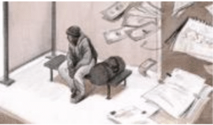
Mathis v. USPC Key Takeaways
Discrimination is “by reason of” disability if disability makes it harder to navigate supervision without needed accommodations
Even if other factors (e.g., housing instability) contribute to downstream harms such as revocation
Mathis v. USPC Case Study

Slide 35
Mathis v. USPC Key Takeaways Cont’d
Denial of equal treatment is itself an “injury”
Even if Plaintiffs ultimately complete supervision without any alleged violations
“The law requires no further downstream harms”
Mathis v. USPC Case Study

Slide 36
Using Disability Law in Daily Practice

Slide 37
Identifying Reasonable Accommodations
Initiate the discussion with your client
Don’t make assumptions about disabilities
Ask open-ended questions
Are there any communication methods that work best for you?
Do you have any difficulty with reading, writing, or understanding information?
Are there any parts of the supervision process that you think might be challenging?
Using Disability Law in Daily Practice

Slide 38
Universal Design in your Practice
Provide flexible scheduling for appointments
Provide materials in plain language
Use teach-back technique rather than asking “do you understand?”
Provide take-home notes
Using Disability Law in Daily Practice

Slide 39
Seeking Accommodations
When to Raise
When conditions are set
During course of supervision
During revocation
How to Raise
Court filings
Informal advocacy with supervision authorities
Demand letter
Caveat: case-specific strategic concerns
Using Disability Law in Daily Practice

Slide 40
Potential Reasonable Accommodations
Moving meetings or making them virtual
Rescheduling appointments
Meeting reminders
Plain language
Consistent schedules and supervision officers
Interpreters or other communication aids
Using Disability Law in Daily Practice

Slide 41
Opportunities for Collaboration
Thought partnership on individual cases
Resource sharing
Investigate systemic violations
Using Disability Law in Daily Practice

Slide 42
Questions and Answers

Slide 43
Resources
Reducing Barriers Report: https://www.aclu.org/publications/reducing-barriers-a-guide-to-obtaining-reasonable-accommodations-for-people-with-disabilities-on-supervision
Cobb Settlement: https://www.aclu.org/documents/settlement-agreement-cobb-v-georgia-department-of-community-supervision
Cobb ADA Policy: https://www.aclu.org/documents/americans-with-disabilities-act-policy-cobb-v-georgia-department-of-community-supervision
Mathis Preliminary Injunction: https://www.aclu.org/cases/mathis-v-united-states-parole-commission?document=Preliminary-Injunction-Opinion
Resources

Slide 44
For More Information
West Resendes, ACLU Disability Rights Program: wresendes@aclu.org
Brian Dimmick, ACLU Disability Rights Program: bdimmick@aclu.org
Allison Frankel, ACLU Criminal Law Reform Project: afrankel@aclu.org
Photo Copyright Flickr-Via Tsuji
Resources

Slide 45
ACLU Logo Slide
WE THE PEOPLE

